Slide 1
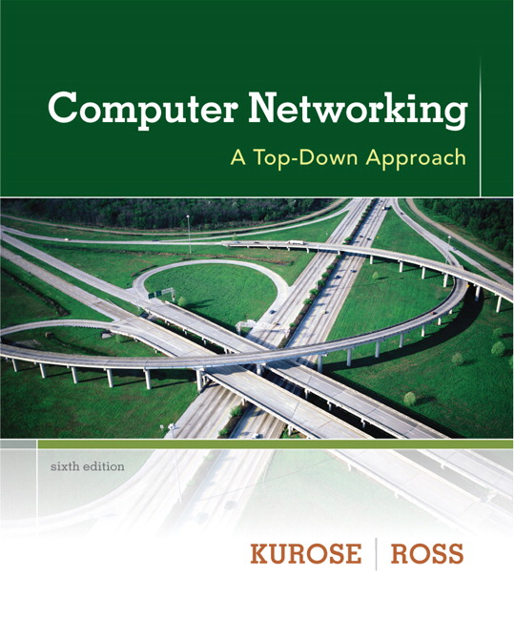
Chapter 4 Network Layer
Computer Networking: A Top Down Approach 6th edition Jim Kurose, Keith Ross Addison-Wesley March 2012
Course Name:
Computer Networks
Lecture by:
Dr. Moeenuddin Tariq

Slide 2
Chapter 4: outline
4.1 introduction
4.2 virtual circuit and datagram networks
4.3 what’s inside a router
4.4 IP: Internet Protocol
datagram format
IPv4 addressing
ICMP
IPv6
4.5 routing algorithms
link state
distance vector
hierarchical routing
4.6 routing in the Internet
RIP
OSPF
BGP
4.7 broadcast and multicast routing

Slide 3
The Internet network layer
host, router network layer functions:
transport layer: TCP, UDP
routing protocols
path selection
RIP, OSPF, BGP
IP protocol
addressing conventions
datagram format
packet handling conventions
network
layer
forwarding
table
ICMP protocol
error reporting
router “signaling”
link layer
physical layer

Slide 4
IP datagram format
IP protocol version
Number
32 bits
total datagram
length (bytes)
header length
(bytes)
head.
len
Prioirty+type
of
Service
ver
length
for
fragmentation/
reassembly
“type” of data
flgs
fragment
offset
16-bit identifier
max number
remaining hops
(decremented at
each router)
time to
live
upper
layer
header
checksum
32 bit source IP address
upper layer protocol
to deliver payload to
32 bit destination IP address
options (if any)
e.g. timestamp,
record route
taken, specify
list of routers
to visit.
data
(variable length,
typically a TCP
or UDP segment)
how much overhead?
20 bytes of TCP
20 bytes of IP
= 40 bytes + app layer overhead

Slide 5

IP fragmentation, reassembly
network links have MTU (max.transfer size) - largest possible link-level frame
different link types, different MTUs
large IP datagram divided (“fragmented”) within net
one datagram becomes several datagrams
“reassembled” only at final destination
IP header bits used to identify, order related fragments
…
fragmentation:
in: one large datagram
out: 3 smaller datagrams
reassembly
…

Slide 6
IP fragmentation, reassembly
length
=4000
ID
=55
fragflag
=0
offset
=0
example:
4000 byte datagram
MTU = 1500 bytes
one large datagram becomes
several smaller datagrams
1480 bytes in data field
length
=1500
ID
=55
fragflag
=1
offset
=0
offset =
1480/8
length
=1500
ID
=55
fragflag
=1
offset
=185
length
=1040
ID
=55
fragflag
=0
offset
=370

Slide 7
Chapter 4: outline
4.1 introduction
4.2 virtual circuit and datagram networks
4.3 what’s inside a router
4.4 IP: Internet Protocol
datagram format
IPv4 addressing
ICMP
IPv6
4.5 routing algorithms
link state
distance vector
hierarchical routing
4.6 routing in the Internet
RIP
OSPF
BGP
4.7 broadcast and multicast routing

Slide 8
IP addressing: introduction
223.1.1.1
IP address: 32-bit identifier for host, router interface
interface: connection between host/router and physical link
router’s typically have multiple interfaces
host typically has one or two interfaces (e.g., wired Ethernet, wireless 802.11)
IP addresses associated with each interface
223.1.2.1
223.1.1.2
223.1.1.4
223.1.2.9
223.1.1.3
223.1.3.27
223.1.2.2
223.1.3.1
223.1.3.2
223.1.1.1 = 11011111 00000001 00000001 00000001
223
1
1
1

Slide 9


IP addressing: introduction
223.1.1.1
Q: how are interfaces actually connected?
A: we’ll learn about that in chapter 5, 6.
223.1.2.1
223.1.1.2
223.1.1.4
223.1.2.9
223.1.1.3
223.1.3.27
223.1.2.2
A: wired Ethernet interfaces connected by Ethernet switches
223.1.3.1
223.1.3.2
For now: don’t need to worry about how one interface is connected to another (with no intervening router)
A: wireless WiFi interfaces connected by WiFi base station

Slide 10
Subnets
IP address:
subnet part - high order bits
host part - low order bits
what’s a subnet ?
device interfaces with same subnet part of IP address
can physically reach each other without intervening router
223.1.1.1
223.1.1.2
223.1.2.1
223.1.1.4
223.1.2.9
223.1.2.2
223.1.1.3
223.1.3.27
subnet
223.1.3.1
223.1.3.2
network consisting of 3 subnets

Slide 11
Subnets
223.1.1.0/24
223.1.2.0/24
recipe
to determine the subnets, detach each interface from its host or router, creating islands of isolated networks
each isolated network is called a subnet
223.1.1.1
223.1.1.2
223.1.2.1
223.1.1.4
223.1.2.9
223.1.2.2
223.1.1.3
223.1.3.27
subnet
223.1.3.1
223.1.3.2
223.1.3.0/24
subnet mask: /24

Slide 12
Subnets
223.1.1.2
how many?
223.1.1.1
223.1.1.4
223.1.1.3
223.1.9.2
223.1.7.0
223.1.9.1
223.1.7.1
223.1.8.1
223.1.8.0
223.1.2.6
223.1.3.27
223.1.2.1
223.1.2.2
223.1.3.1
223.1.3.2

Slide 13
IP addressing: CIDR
CIDR: Classless InterDomain Routing
subnet portion of address of arbitrary length
address format: a.b.c.d/x, where x is # bits in subnet portion of address
subnet
part
host
part
11001000 00010111 00010000 00000000
200.23.16.0/23

Slide 14
IP addresses: how to get one?
Q: How does a host get IP address?
hard-coded by system admin in a file
Windows: control-panel->network->configuration->tcp/ip->properties
UNIX: /etc/rc.config
DHCP: Dynamic Host Configuration Protocol: dynamically get address from as server
“plug-and-play”

Slide 15
DHCP: Dynamic Host Configuration Protocol
goal: allow host to dynamically obtain its IP address from network server when it joins network
can renew its lease on address in use
allows reuse of addresses (only hold address while connected/“on”)
support for mobile users who want to join network (more shortly)
DHCP overview:
host broadcasts “DHCP discover” msg [optional]
DHCP server responds with “DHCP offer” msg [optional]
host requests IP address: “DHCP request” msg
DHCP server sends address: “DHCP ack” msg

Slide 16


DHCP client-server scenario
DHCP
server
223.1.1.0/24
223.1.1.1
223.1.2.1
223.1.1.2
arriving DHCP
client needs
address in this
network
223.1.1.4
223.1.2.9
223.1.3.27
223.1.2.2
223.1.1.3
223.1.2.0/24
223.1.3.1
223.1.3.2
223.1.3.0/24

Slide 17
DHCP client-server scenario
DHCP server: 223.1.2.5
DHCP discover
arriving
client
src : 0.0.0.0, 68
dest.: 255.255.255.255,67
yiaddr: 0.0.0.0
transaction ID: 654
Broadcast: is there a DHCP server out there?
DHCP offer
src: 223.1.2.5, 67
dest: 255.255.255.255, 68
yiaddrr: 223.1.2.4
transaction ID: 654
lifetime: 3600 secs
Broadcast: I’m a DHCP server! Here’s an IP address you can use
DHCP request
src: 0.0.0.0, 68
dest:: 255.255.255.255, 67
yiaddrr: 223.1.2.4
transaction ID: 655
lifetime: 3600 secs
Broadcast: OK. I’ll take that IP address!
DHCP ACK
src: 223.1.2.5, 67
dest: 255.255.255.255, 68
yiaddrr: 223.1.2.4
transaction ID: 655
lifetime: 3600 secs
Broadcast: OK. You’ve got that IP address!

Slide 18
DHCP: more than IP addresses
DHCP can return more than just allocated IP address on subnet:
address of first-hop router for client
name and IP address of DNS sever
network mask (indicating network versus host portion of address)

Slide 19


DHCP: example
DHCP
DHCP
UDP
IP
Eth
Phy
connecting laptop needs its IP address, addr of first-hop router, addr of DNS server: use DHCP
DHCP
DHCP
DHCP
DHCP
DHCP request encapsulated in UDP, encapsulated in IP, encapsulated in 802.1 Ethernet
DHCP
DHCP
UDP
IP
Eth
Phy
168.1.1.1
DHCP
DHCP
DHCP
Ethernet frame broadcast (dest: FFFFFFFFFFFF) on LAN, received at router running DHCP server
DHCP
router with DHCP
server built into
router
Ethernet demuxed to IP demuxed, UDP demuxed to DHCP

Slide 20
DHCP: example
DHCP
UDP
IP
Eth
Phy
DCP server formulates DHCP ACK containing client’s IP address, IP address of first-hop router for client, name & IP address of DNS server
DHCP
DHCP
DHCP
DHCP
encapsulation of DHCP server, frame forwarded to client, demuxing up to DHCP at client
DHCP
DHCP
UDP
IP
Eth
Phy
DHCP
DHCP
DHCP
router with DHCP
server built into
router
client now knows its IP address, name and IP address of DSN server, IP address of its first-hop router
DHCP

Slide 21
DHCP: Wireshark output (home LAN)
reply
Message type: Boot Reply (2)
Hardware type: Ethernet
Hardware address length: 6
Hops: 0
Transaction ID: 0x6b3a11b7
Seconds elapsed: 0
Bootp flags: 0x0000 (Unicast)
Client IP address: 192.168.1.101 (192.168.1.101)
Your (client) IP address: 0.0.0.0 (0.0.0.0)
Next server IP address: 192.168.1.1 (192.168.1.1)
Relay agent IP address: 0.0.0.0 (0.0.0.0)
Client MAC address: Wistron_23:68:8a (00:16:d3:23:68:8a)
Server host name not given
Boot file name not given
Magic cookie: (OK)
Option: (t=53,l=1) DHCP Message Type = DHCP ACK
Option: (t=54,l=4) Server Identifier = 192.168.1.1
Option: (t=1,l=4) Subnet Mask = 255.255.255.0
Option: (t=3,l=4) Router = 192.168.1.1
Option: (6) Domain Name Server
Length: 12; Value: 445747E2445749F244574092;
IP Address: 68.87.71.226;
IP Address: 68.87.73.242;
IP Address: 68.87.64.146
Option: (t=15,l=20) Domain Name = "hsd1.ma.comcast.net."
Message type: Boot Request (1)
Hardware type: Ethernet
Hardware address length: 6
Hops: 0
Transaction ID: 0x6b3a11b7
Seconds elapsed: 0
Bootp flags: 0x0000 (Unicast)
Client IP address: 0.0.0.0 (0.0.0.0)
Your (client) IP address: 0.0.0.0 (0.0.0.0)
Next server IP address: 0.0.0.0 (0.0.0.0)
Relay agent IP address: 0.0.0.0 (0.0.0.0)
Client MAC address: Wistron_23:68:8a (00:16:d3:23:68:8a)
Server host name not given
Boot file name not given
Magic cookie: (OK)
Option: (t=53,l=1) DHCP Message Type = DHCP Request
Option: (61) Client identifier
Length: 7; Value: 010016D323688A;
Hardware type: Ethernet
Client MAC address: Wistron_23:68:8a (00:16:d3:23:68:8a)
Option: (t=50,l=4) Requested IP Address = 192.168.1.101
Option: (t=12,l=5) Host Name = "nomad"
Option: (55) Parameter Request List
Length: 11; Value: 010F03062C2E2F1F21F92B
1 = Subnet Mask; 15 = Domain Name
3 = Router; 6 = Domain Name Server
44 = NetBIOS over TCP/IP Name Server
……
request

Slide 22
IP addresses: how to get one?
Q: how does network get subnet part of IP addr?
A: gets allocated portion of its provider ISP’s address space
ISP's block 11001000 00010111 00010000 00000000 200.23.16.0/20
Organization 0 11001000 00010111 00010000 00000000 200.23.16.0/23
Organization 1 11001000 00010111 00010010 00000000 200.23.18.0/23
Organization 2 11001000 00010111 00010100 00000000 200.23.20.0/23
... ….. …. ….
Organization 7 11001000 00010111 00011110 00000000 200.23.30.0/23

Slide 23
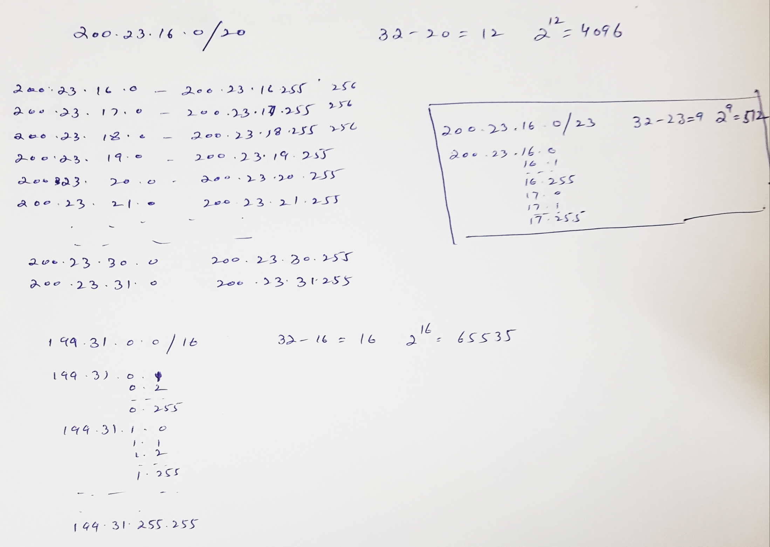

Slide 24
Hierarchical addressing: route aggregation
hierarchical addressing allows efficient advertisement of routing
information:
Organization 0
200.23.16.0/23
Organization 1
200.23.18.0/23
“Send me anything
with addresses
beginning
200.23.16.0/20”
Organization 2
200.23.20.0/23
.
Fly-By-Night-ISP
.
.
.
.
Internet
Organization 7
.
200.23.30.0/23
ISPs-R-Us
“Send me anything
with addresses
beginning
199.31.0.0/16”

Slide 25
Hierarchical addressing: more specific routes
ISPs-R-Us has a more specific route to Organization 1
Organization 0
200.23.16.0/23
“Send me anything
with addresses
beginning
200.23.16.0/20”
Organization 2
200.23.20.0/23
.
Fly-By-Night-ISP
.
.
.
.
Internet
Organization 7
.
200.23.30.0/23
ISPs-R-Us
“Send me anything
with addresses
beginning 199.31.0.0/16
or 200.23.18.0/23”
Organization 1
200.23.18.0/23

Slide 26
IP addressing: the last word...
Q: how does an ISP get block of addresses?
A: ICANN: Internet Corporation for Assigned
Names and Numbers http://www.icann.org/
allocates addresses
manages DNS
assigns domain names, resolves disputes

